Slide 1


Slide 2


NOVEL WEB
GROUP 19

Slide 3

Table of contents
Introduction
Overall description
Detailed Requirement
Supplementary Specification
References
3

Slide 4

Introduction
This web application provides an online library for sharing and reading novels.
Users can read many famous novel for free or with a VIP membership.
5

Slide 5
Actors
User: people who use website to read their novel online.
They can: add new novels to their favorite lists, search for a novel, read the novel, rate a novel or comment on a novel.
VNPAY system: executes transaction between user and the Novel website.
Administrator: Manage users, items in the database.
6

Slide 6

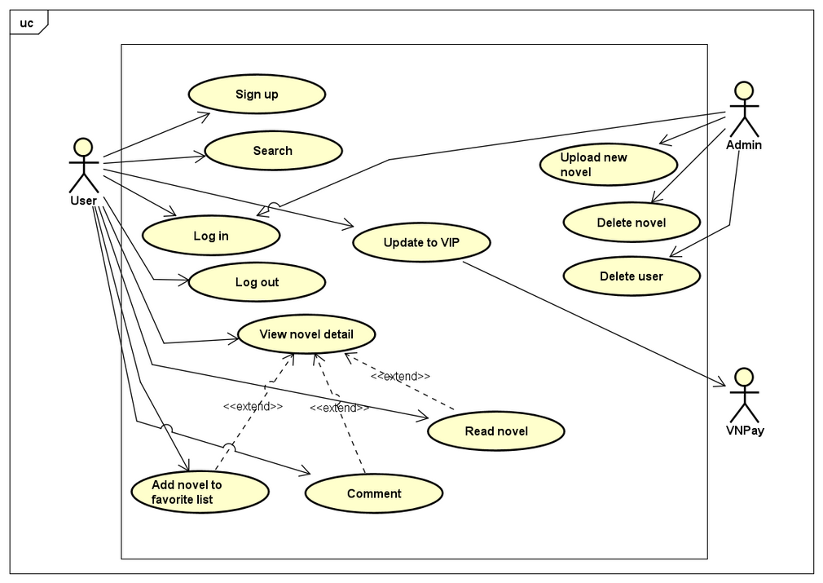
Use case Diagram
7

Slide 7
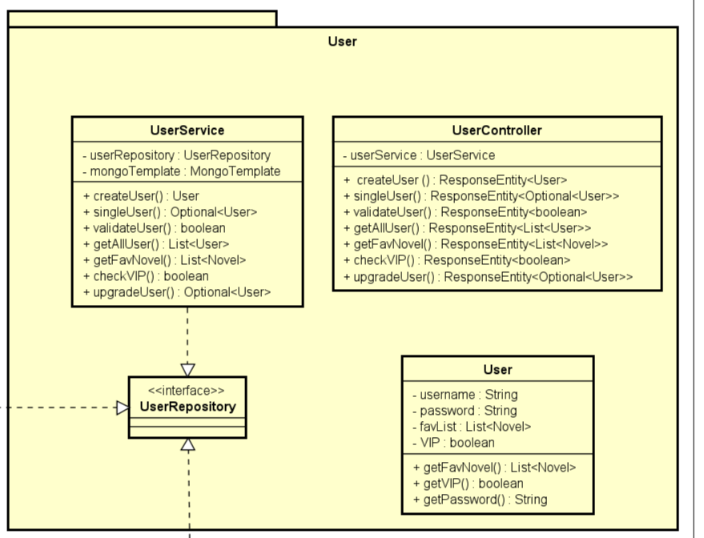
Class Diagram - User
7

Slide 8
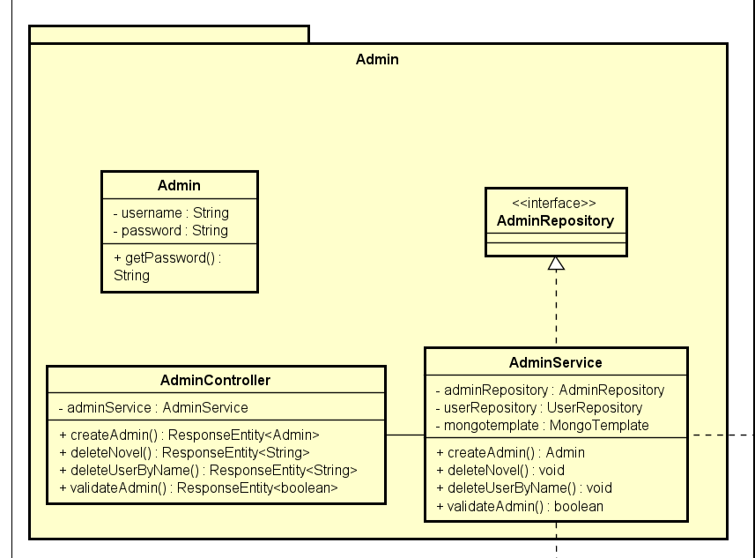
Class Diagram - Admin
7

Slide 9
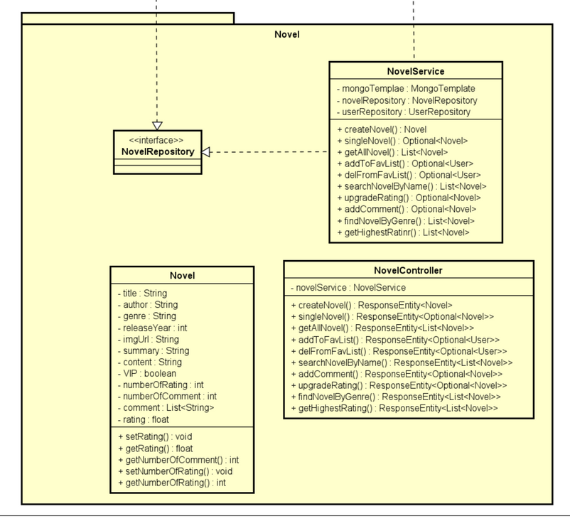
Class Diagram - Novel Web
7

Slide 10
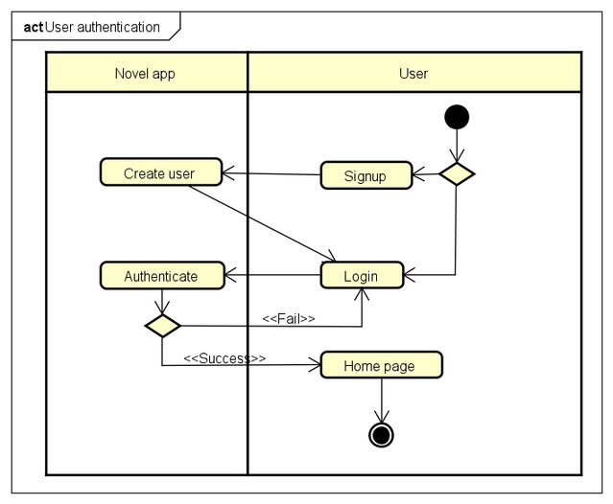
Activity Diagram - User Authentication
8

Slide 11
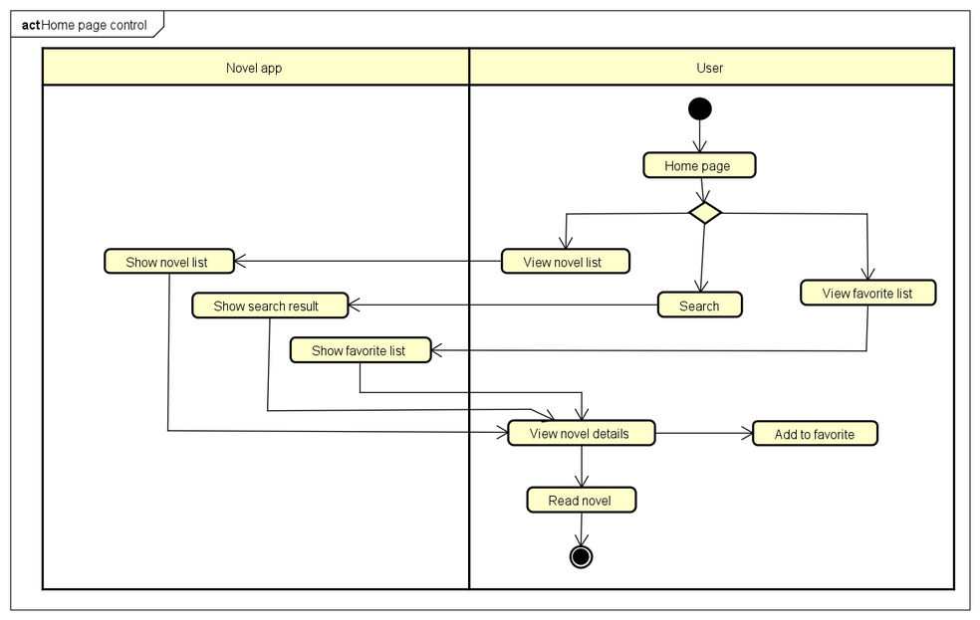
Activity Diagram - Home Page Control
8

Slide 12
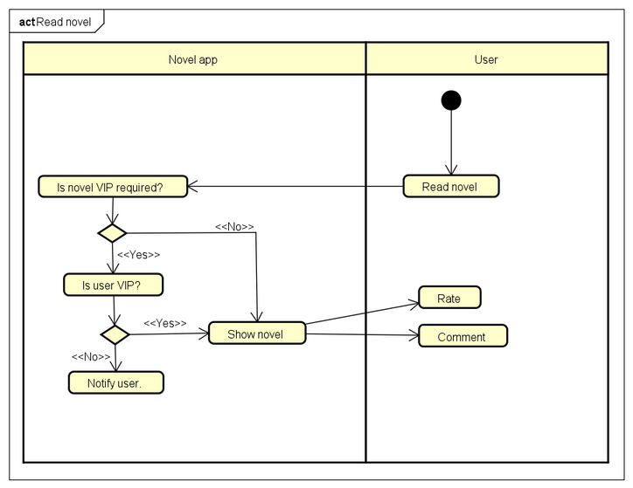
Activity Diagram - Read Novel
8

Slide 13
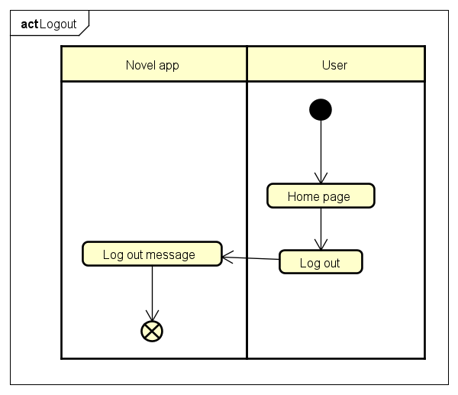
Activity Diagram - Logout
8

Slide 14
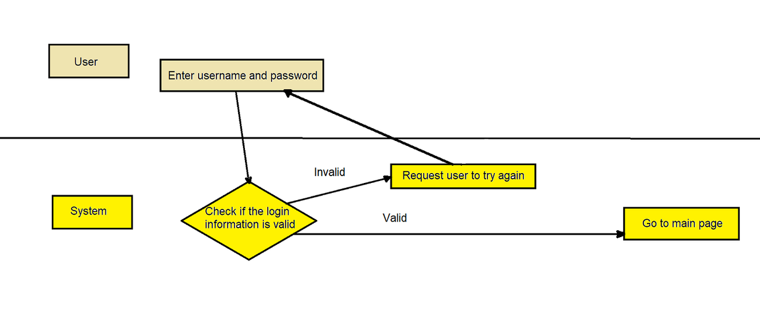
Detailed Requirement - Use Case "Login"
Use case code: UC001
Brief Description: describe the interaction between user, Novel website when user wants to login to their account
5

Slide 15
Detailed Requirement - Use Case "Read Novel"
Use case code: UC002
Brief Description: describe the interaction between user and Novel website when user wishes to read a novel
Actor: User and Novel website
5

Slide 16
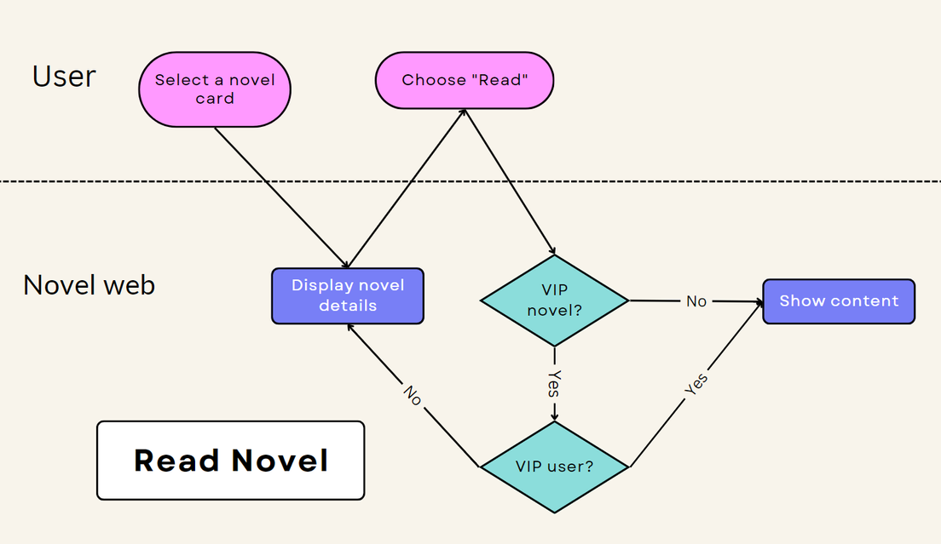
Detailed Requirement - Use Case "Read Novel"
Flow of Event:
5

Slide 17
Detailed Requirement - Use Case "Upgrade to VIP"
Use case code: UC003
Brief Description: describe the interaction between user, Novel website and the VNPay system when user wants to upgrade to VIP membership
5

Slide 18
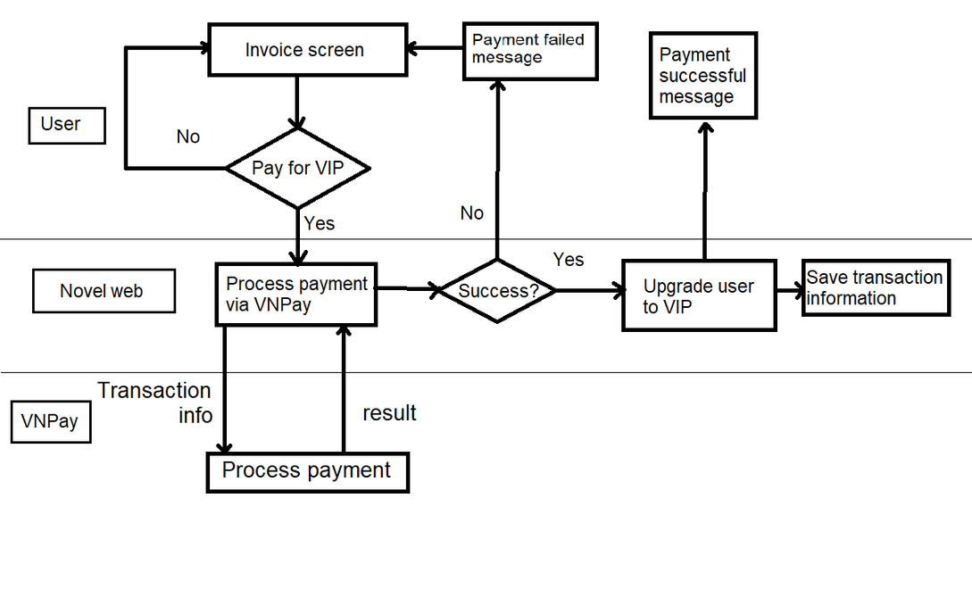
Detailed Requirement - Use Case "Upgrade to VIP"
Flow of Event:
5

Slide 19

THANK YOU !
9

